Slide 1
Course code : CSE3009 Course title : No SQL Data Bases Module : 1 Topic : 6
Brewer’s CAP theorem

Slide 2
Objectives
This session will give the knowledge about
Understanding trade-offs with Brewer’s CAP theorem

Slide 3
Introduction
In order to make the best decision about what to do when systems fail, you need to consider the properties of consistency and availability when working with distributed systems over unreliable networks.
Eric Brewer first introduced the CAP theorem in 2000. The CAP theorem states that any distributed database system can have at most two of the following three desirable properties:
Consistency
High Availability
Partition tolerance

Slide 4
Consistency
Having a single, up-to-date, readable version of your data available to all clients.
This isn’t the same as the consistency we talked about in ACID.
Consistency here is concerned with multiple clients reading the same items from replicated partitions and getting consistent results.

Slide 5
High availability
Knowing that the distributed database will always allow database clients to update items without delay.
Internal communication failures between replicated data shouldn’t prevent updates.

Slide 6
Partition tolerance
The ability of the system to keep responding to client requests even if there’s a communication failure between database partitions.
This is analogous to a person still having an intelligent conversation even after a link between parts of their brain isn’t working.

Slide 7
Trade-offs in CAP Theorem
CAP theorem only applies in cases when there’s a broken connection between partitions in your cluster.
The more reliable your network, the lower the probability you’ll need to think about CAP.
CAP theorem helps you understand that once you partition your data, you must consider the availability-consistency spectrum in a network failure situation.
Then the CAP theorem allows you to determine which options best match your business requirements.

Slide 8
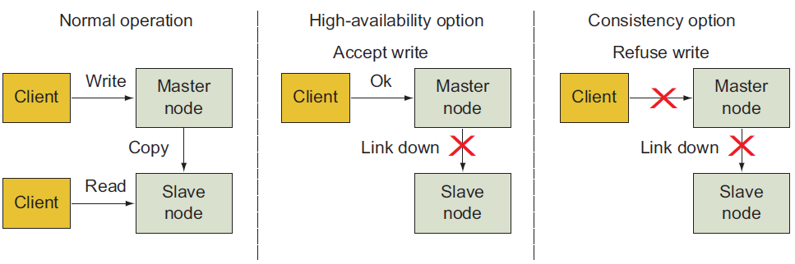
Trade-offs in CAP Theorem

Slide 9
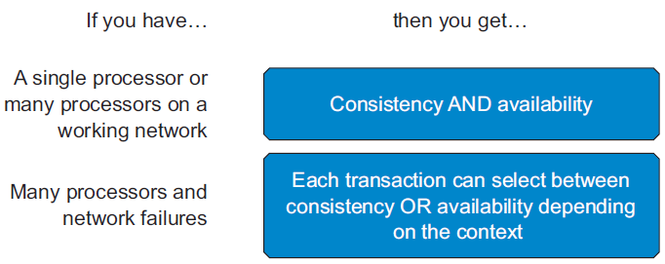
CAP Theorem Rules
The CAP theorem shows that
You can have both consistency and availability if you’re only using a single processor.
If you’re using many processors, you can chose between consistency and availability depending on the transaction type, user, estimated downtime, or other factors.

Slide 10
Conclusion
Tools like the CAP theorem can help guide database selection discussions within an organization and prioritize what properties (consistency, availability, and scalability) are most important.
If high consistency and update availability are simultaneously required, then a faster single processor might be your best choice.
If you need the scale-out benefits that distributed systems offer, then you can make decisions about your need for update availability versus read consistency for each transaction type.

Slide 11
Summary
This session will give the knowledge about
Understanding trade-offs with Brewer’s CAP theorem

